Slide 1
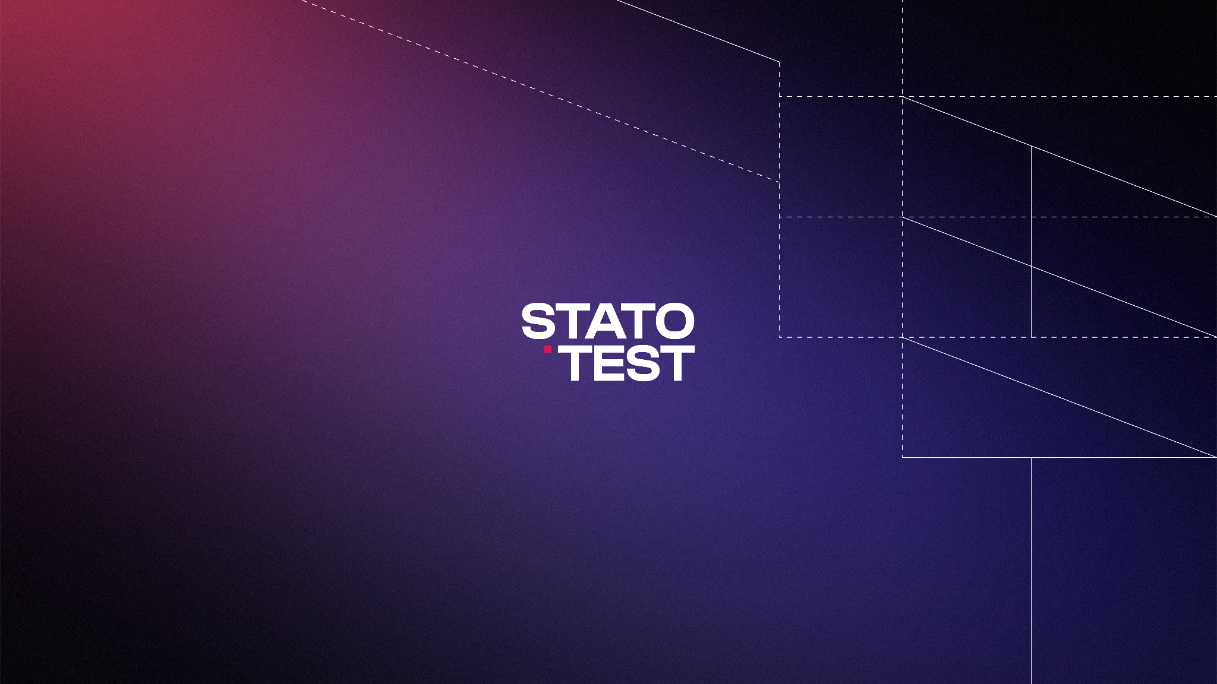

Slide 2
Small visual changes. Stronger presence. Clearer communication.
The goal of this update is not to redesign the brand, but to strengthen how Statotest communicates - making visuals clearer, more consistent, and aligned with both infrastructure and IT expertise.

Slide 3


What will we do:

Slide 4
Uplifting the Logo
Simplified, cleaner geometry
More modern + technical presence
Balancing infrastructure & IT perception
Evolution, not redesign

Slide 5
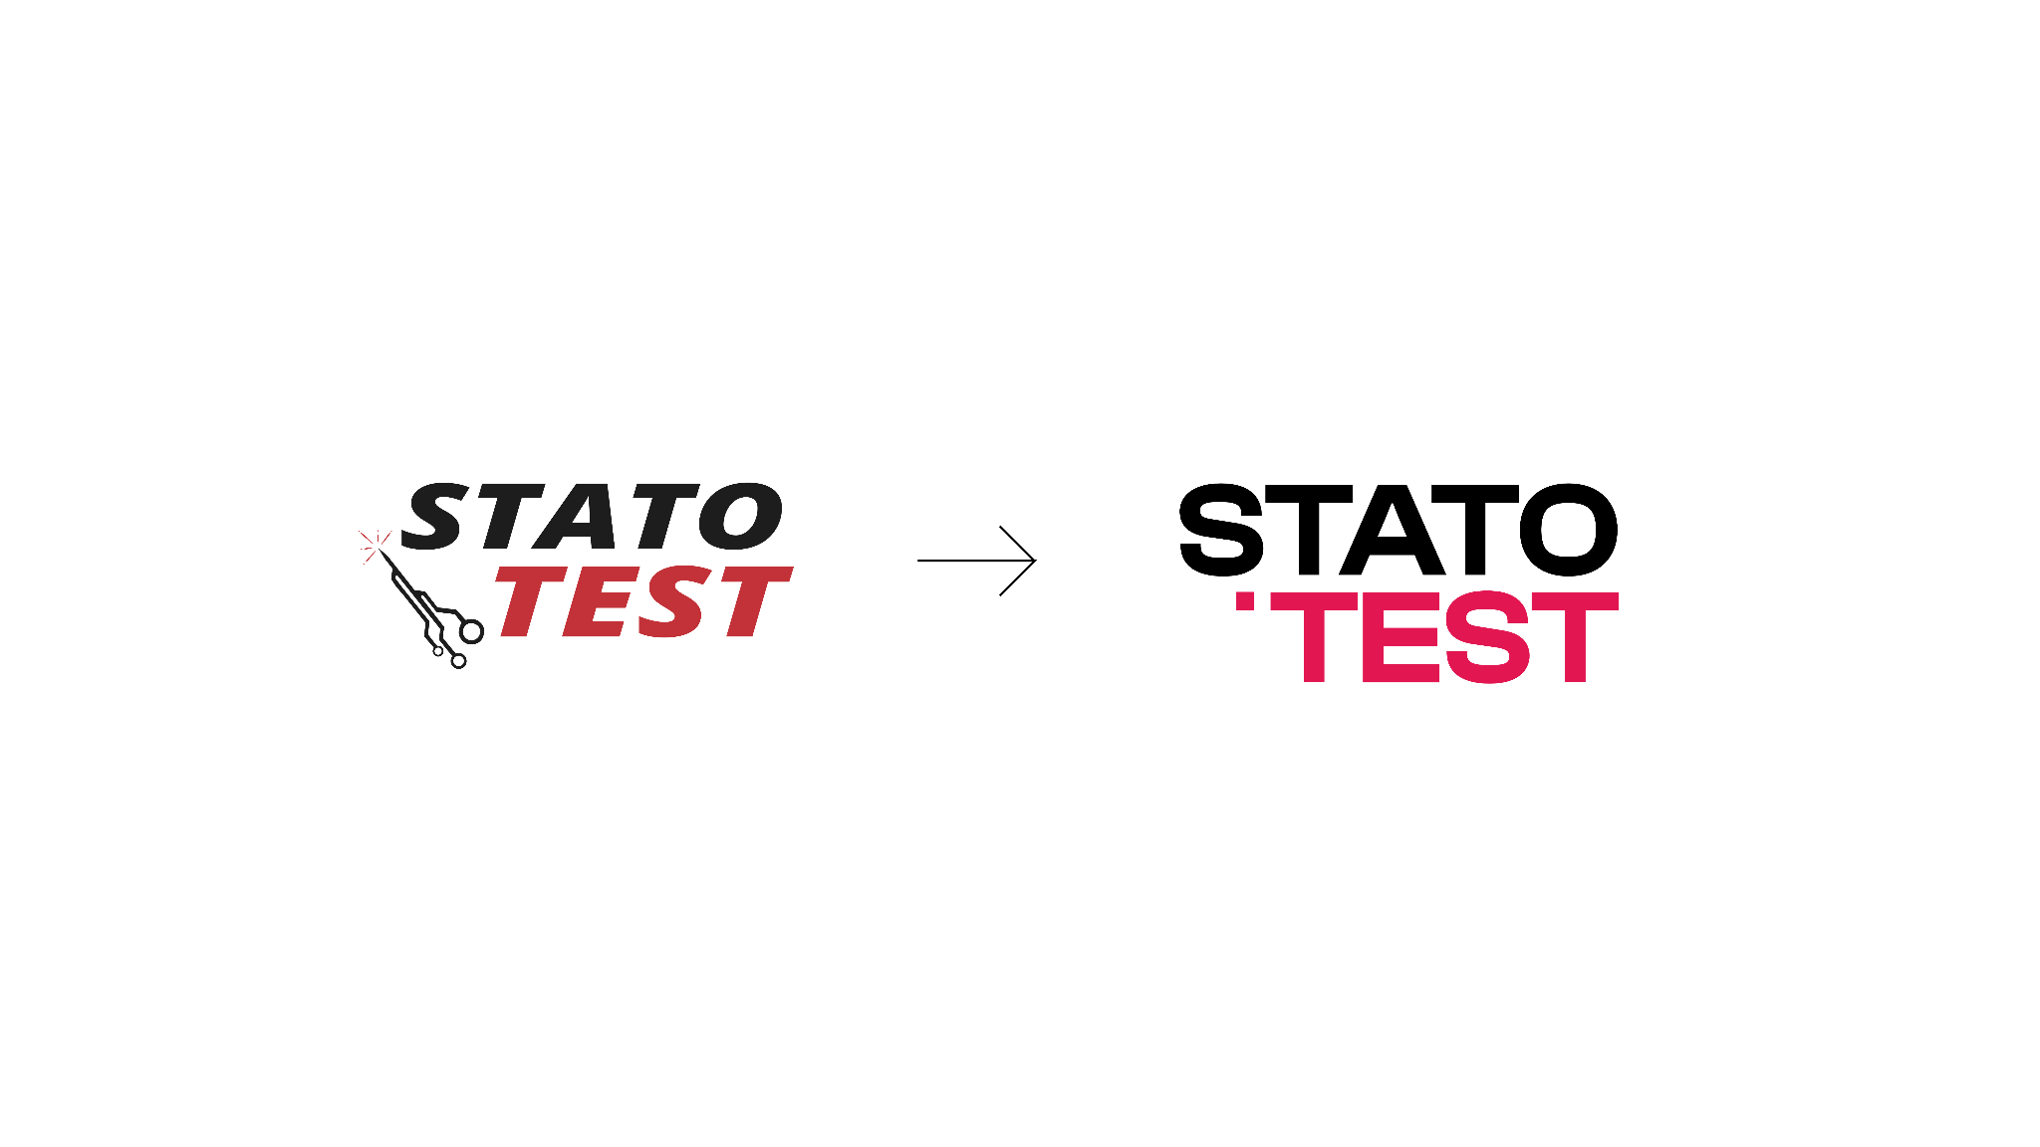

Slide 6
Color rearrangement
Less red → more control, less “alarm”
Blue as a stable, trustworthy base
Red used as a monitoring signal
Gradient = continuity & steady progress
Differentiation from red-heavy competitor

Slide 7
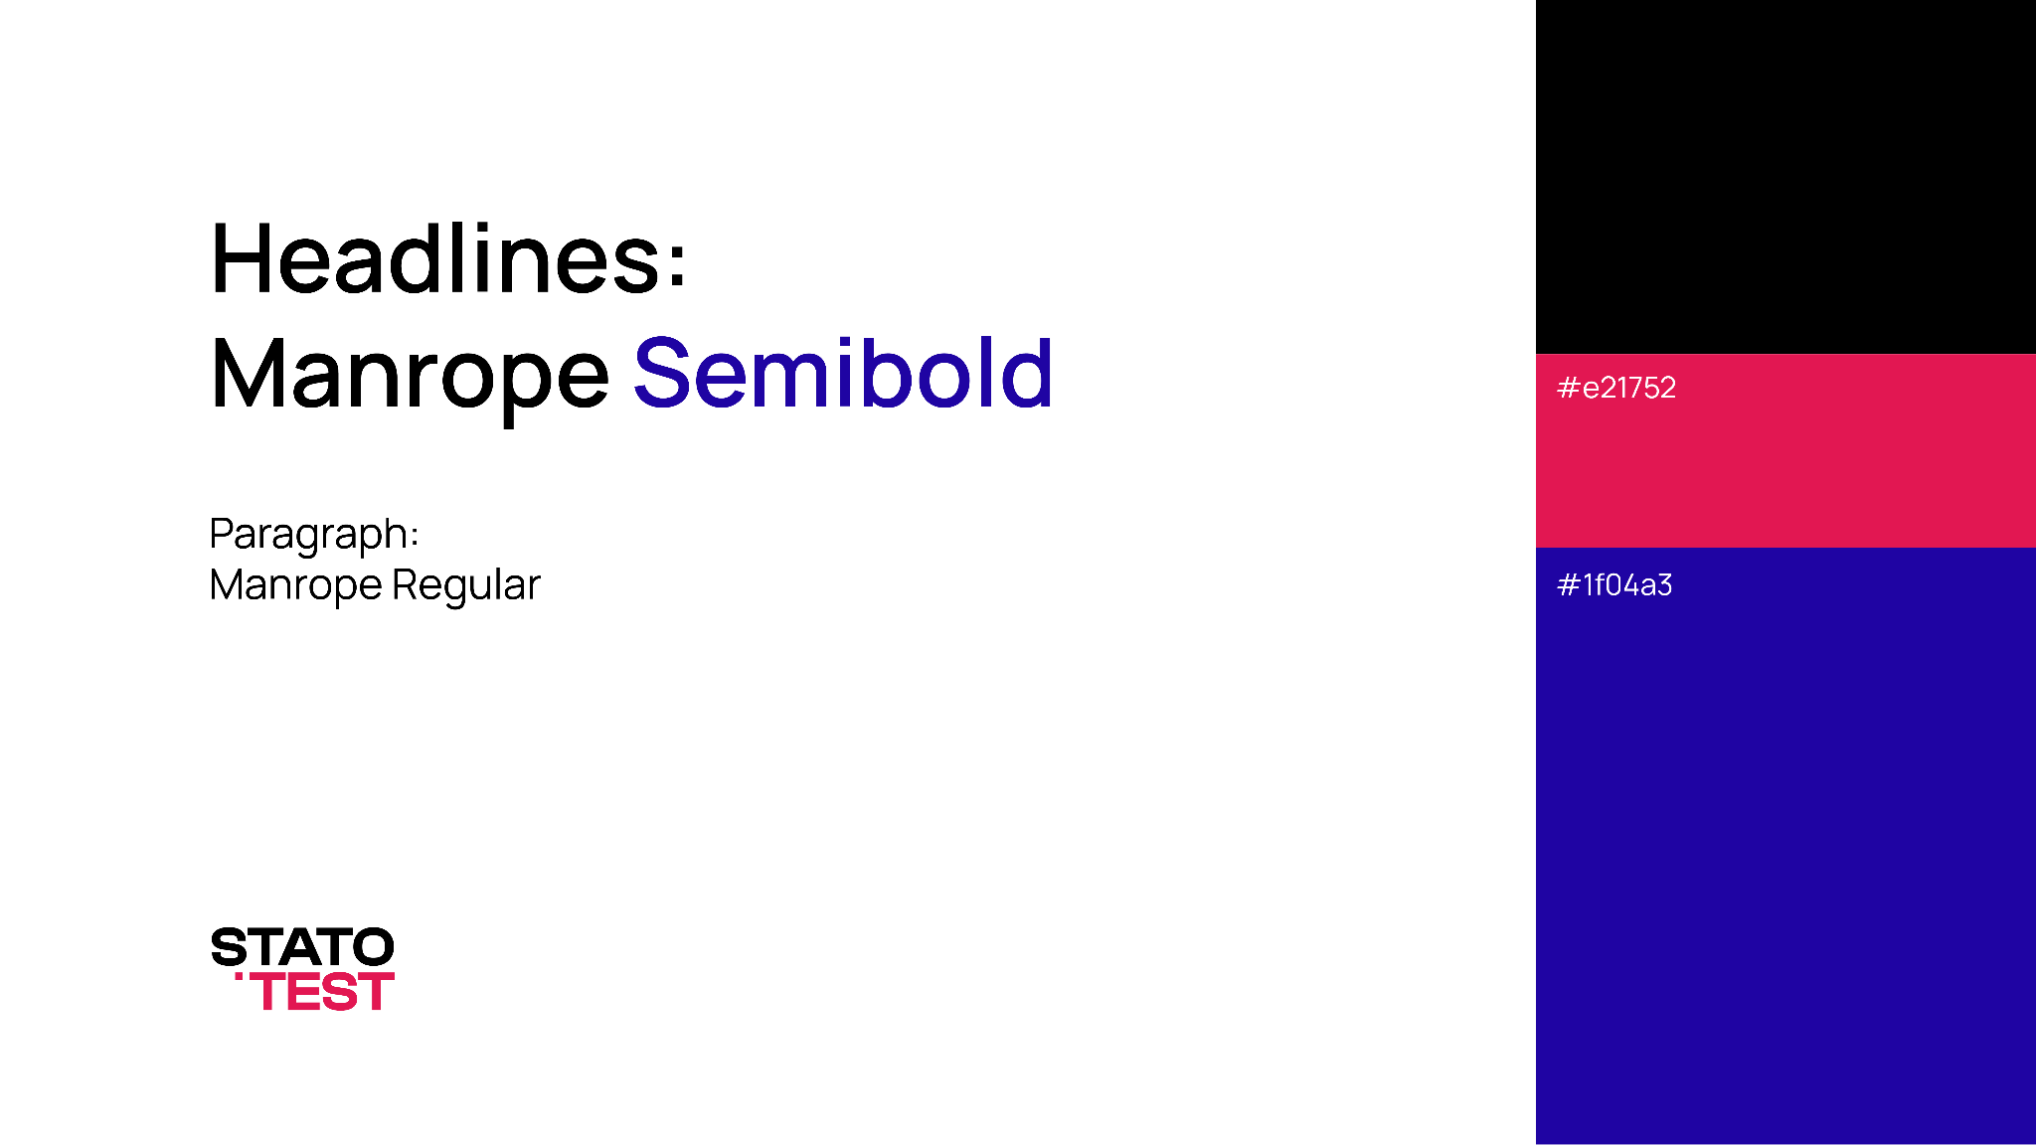

Slide 8
General mood
Blueprint-style graphic system
Minimal, adaptable line compositions
Slightly desaturated photography
Cleaner, more consistent visual tone

Slide 9
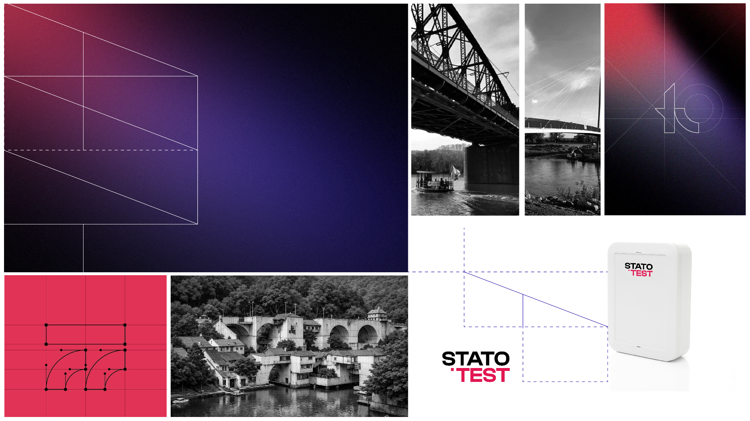

Slide 10
New slide template will have:
Refreshed colors + typography
Structured layouts
Consistent visual language across materials

Slide 11
How will it look:

Slide 12
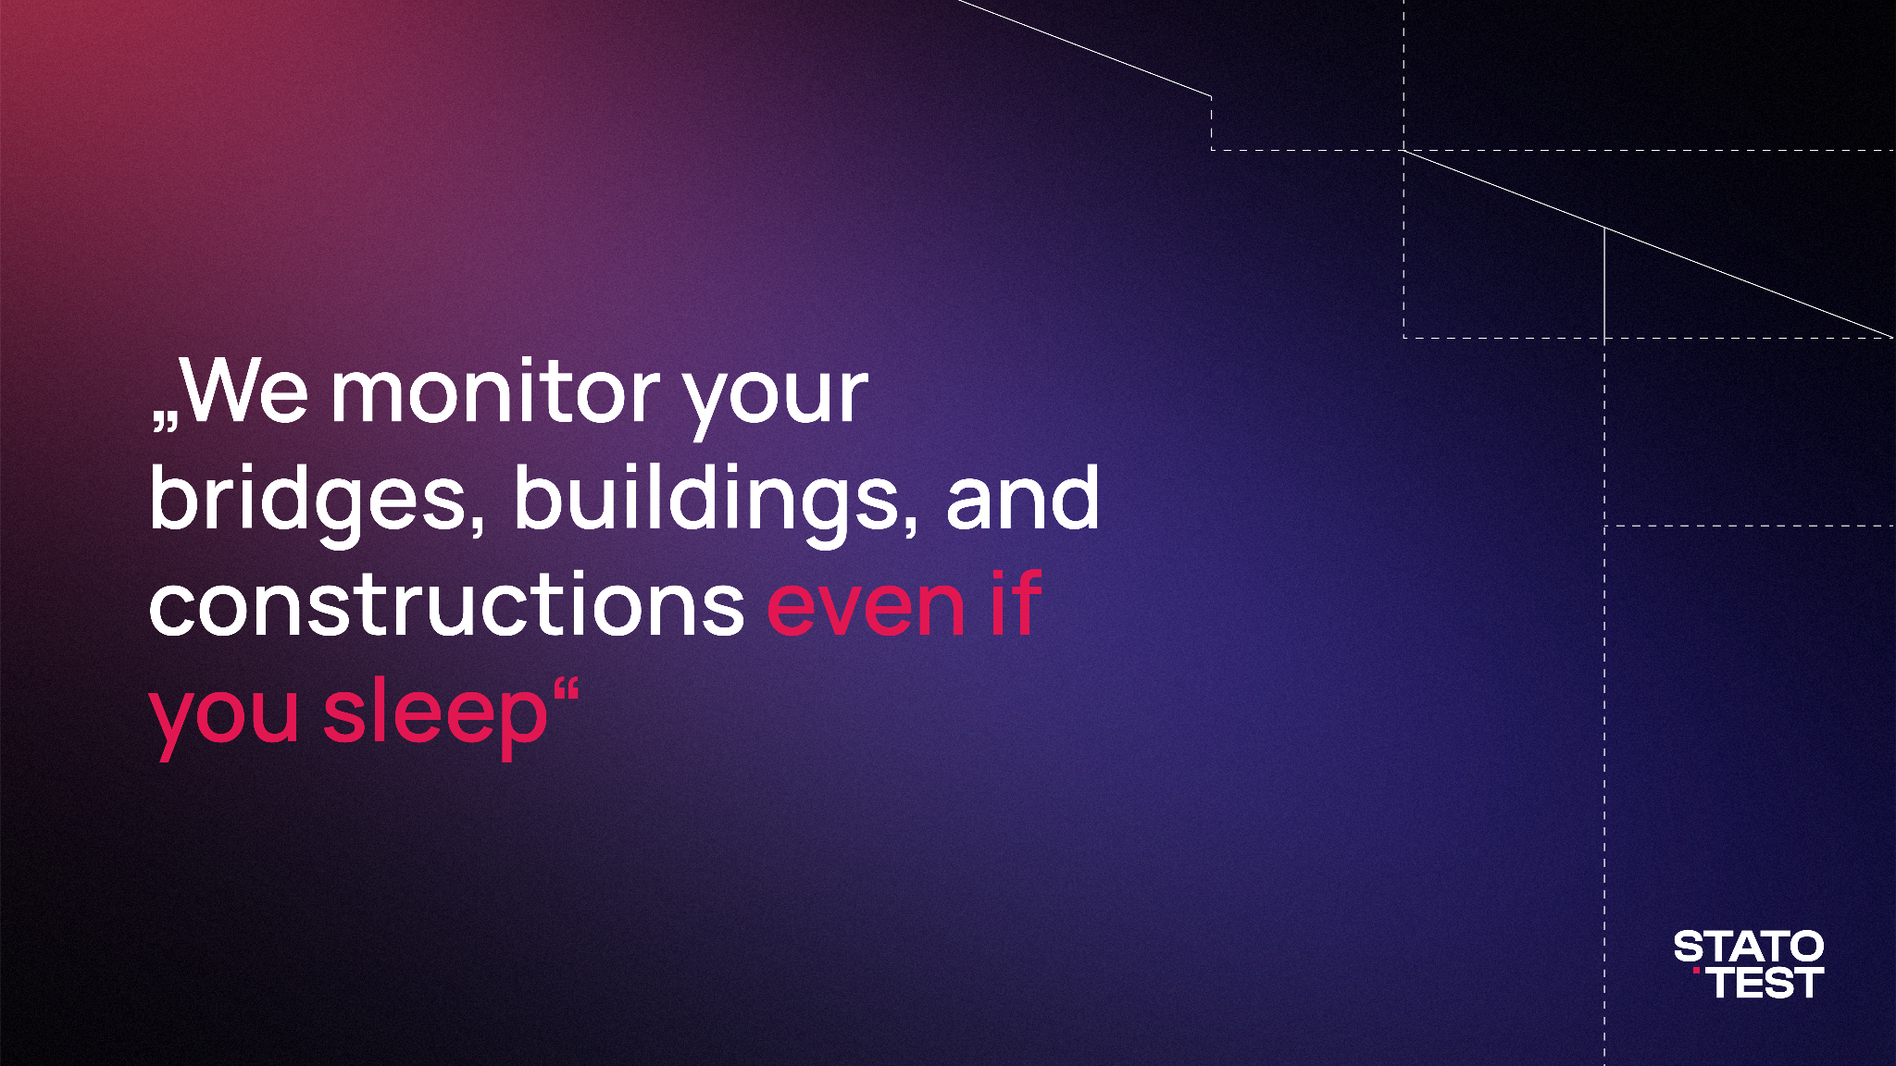

Slide 13
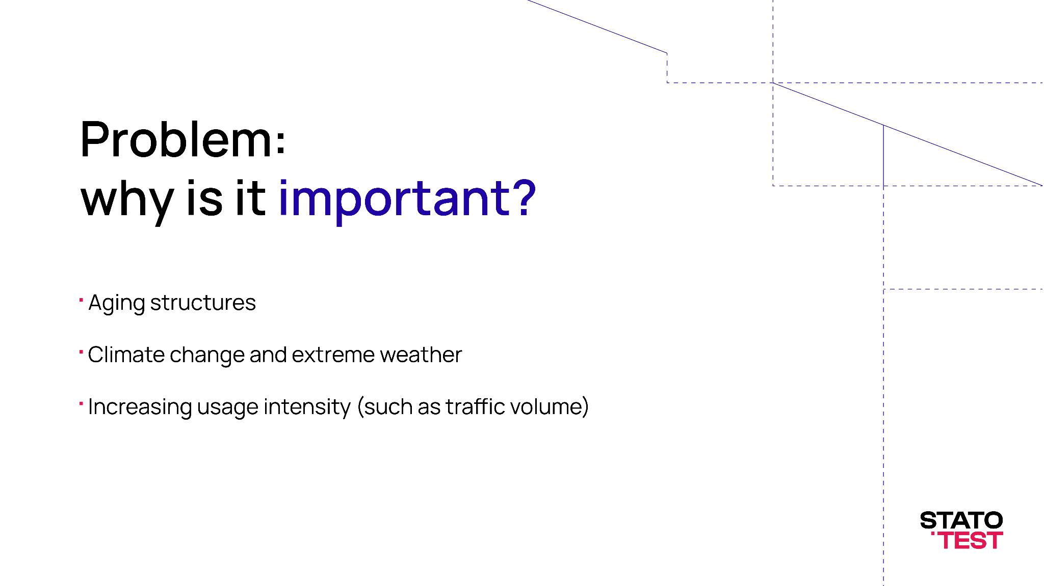

Slide 14
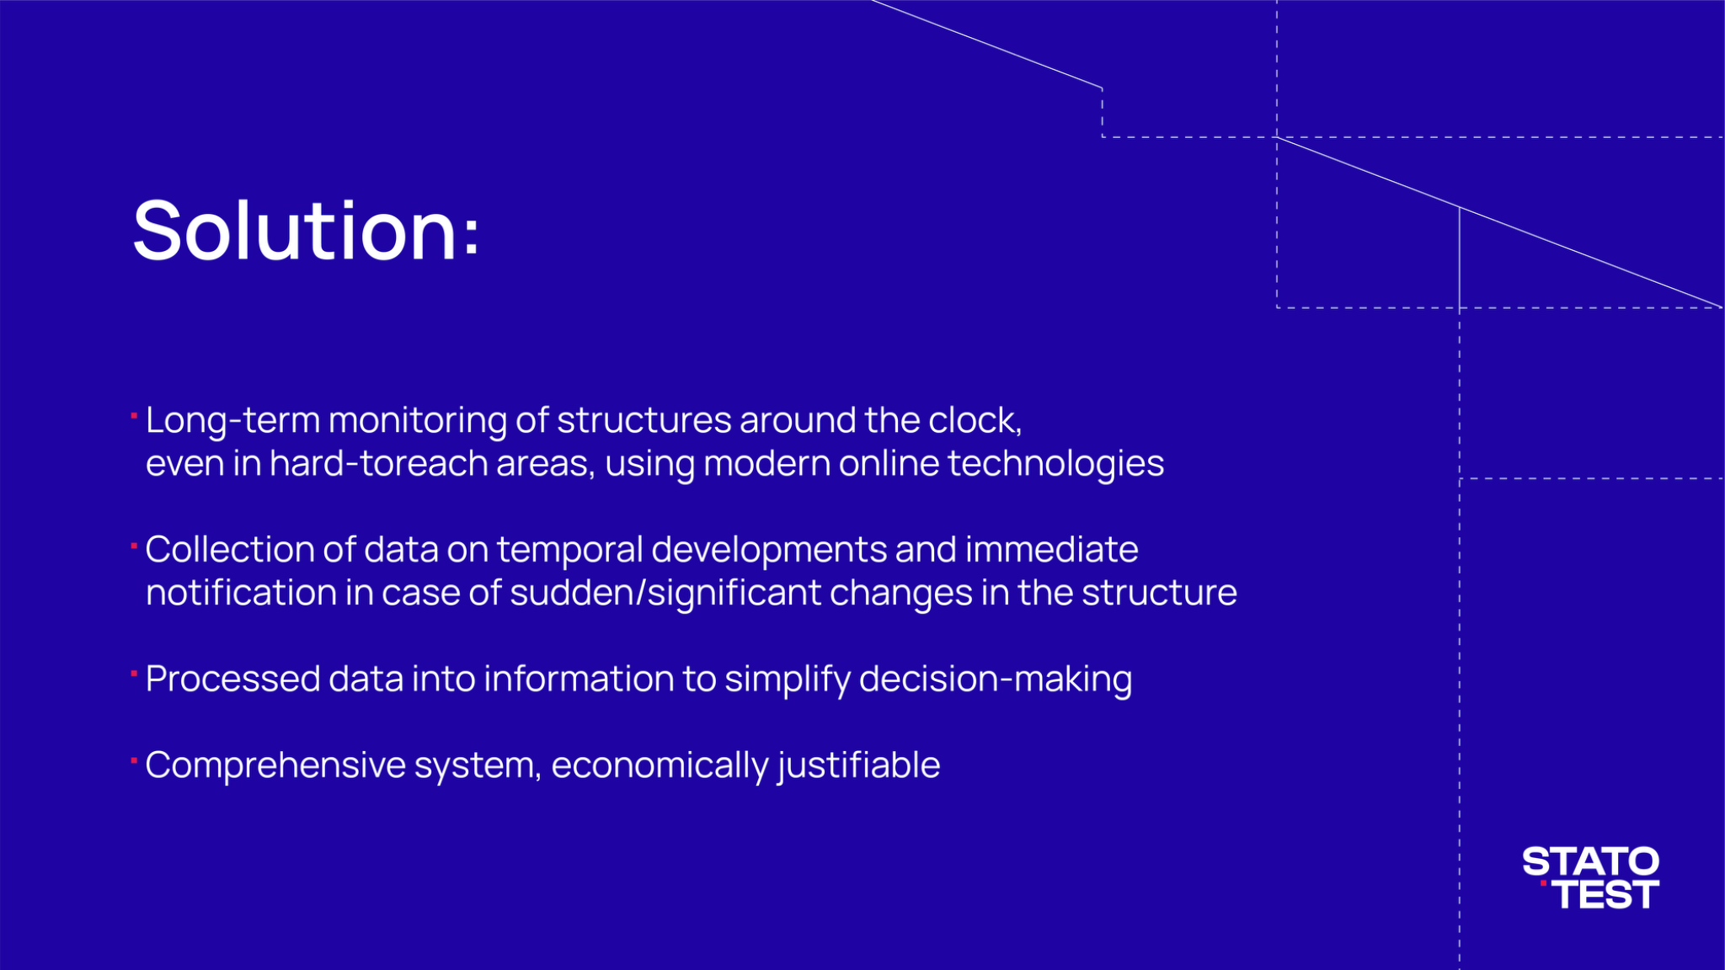

Slide 15
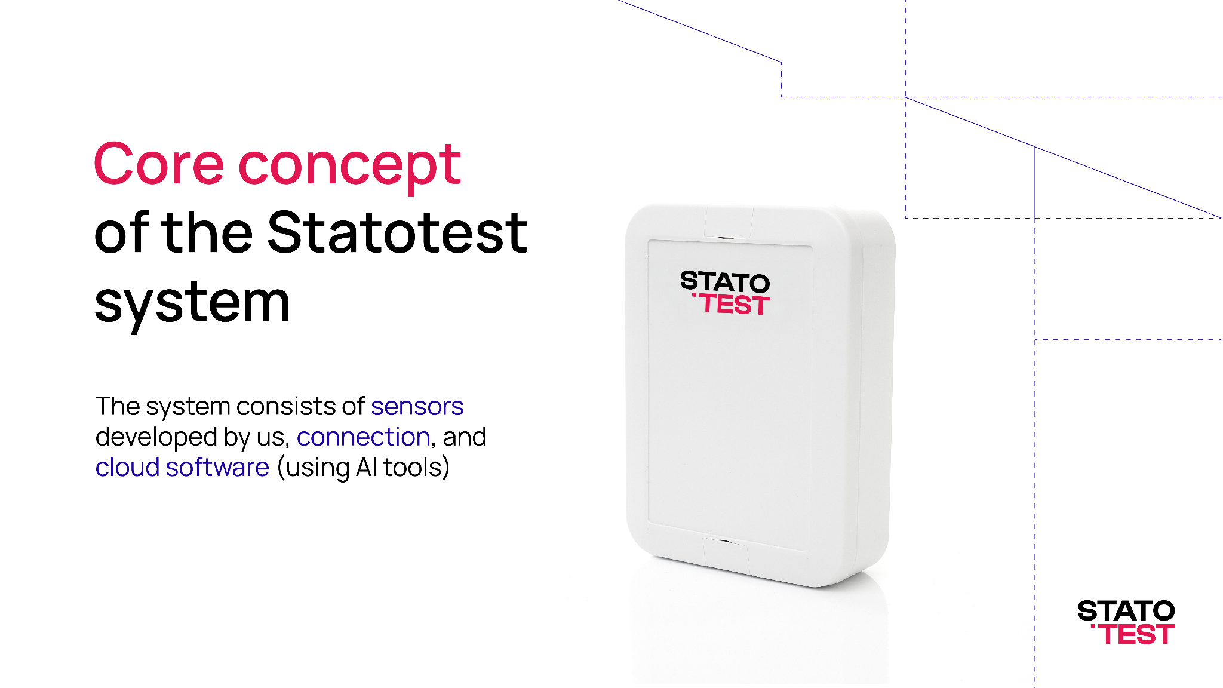

Slide 16
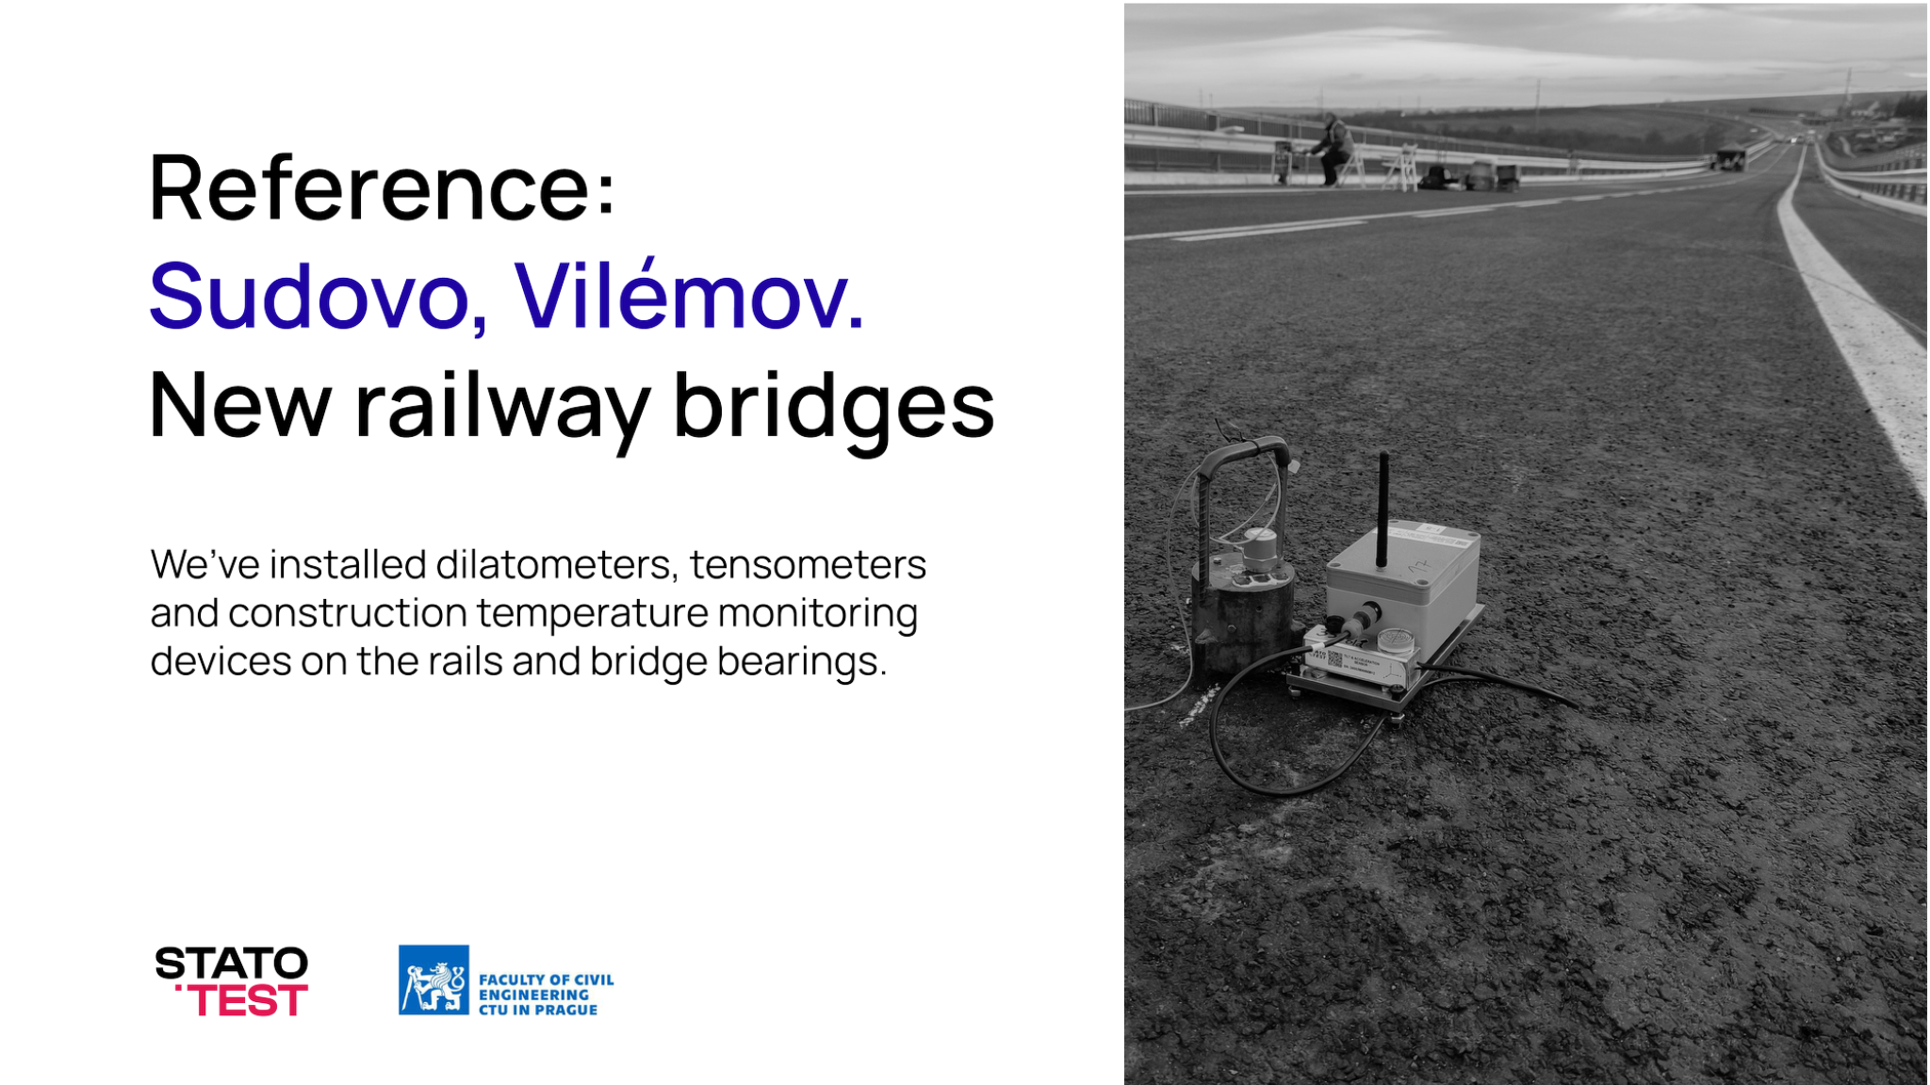

Slide 17
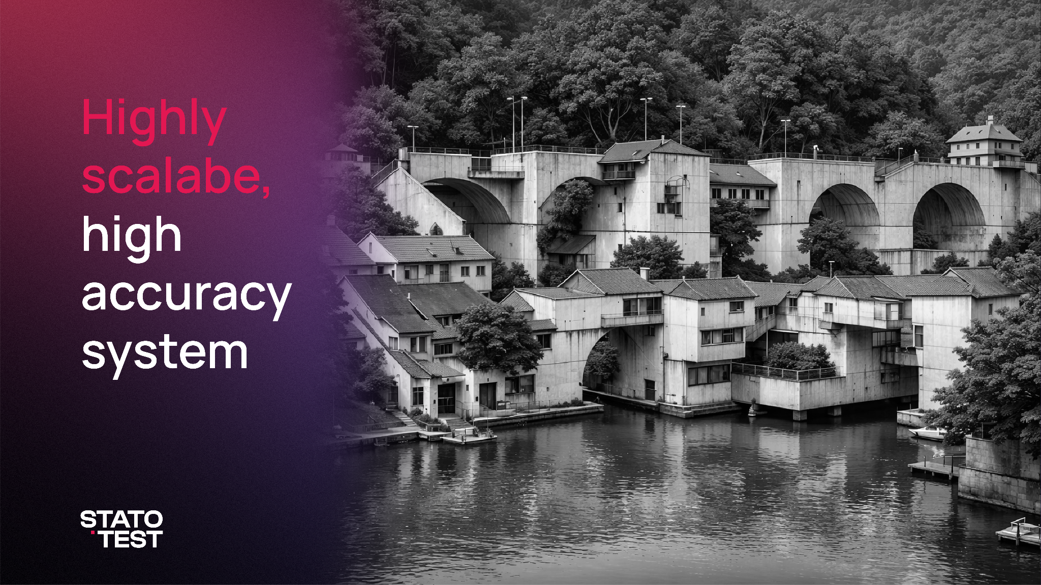

Slide 18
Tips and tricks:

Slide 19
How to keep consistency
More spacing. avoid placing elements too close to each other. Breathing room improves clarity and professionalism.
Reduce visual clutter. fewer elements create stronger impact and make technical content easier to understand.
Prioritize hierarchy. one main message per slide or visual. Supporting information should remain secondary.
Avoid overloading. it’s better to use more slides with clear focus than one slide with too much information.
Align to a consistent grid. structured alignment reflects engineering precision.
Use less red. treat it as a signal or indicator, not a dominant color.
Desaturate photography. this helps maintain brand consistency and prevents visuals from competing with core colors.
Stick to consistent typography. avoid mixing too many styles or effects.
Link to graphic elements here
Link to PPT template here

